Slide 1
Introduction to Java

Slide 2
Module Objectives
At the end of this module, you will be able to:
Discuss the different features of Java.
Know the Java Virtual Machine and how it works.
Show how to start and run a Java program.
Explain how to import classes and ways to access it.
Know the instances and methods in formatting outputs.

Slide 3
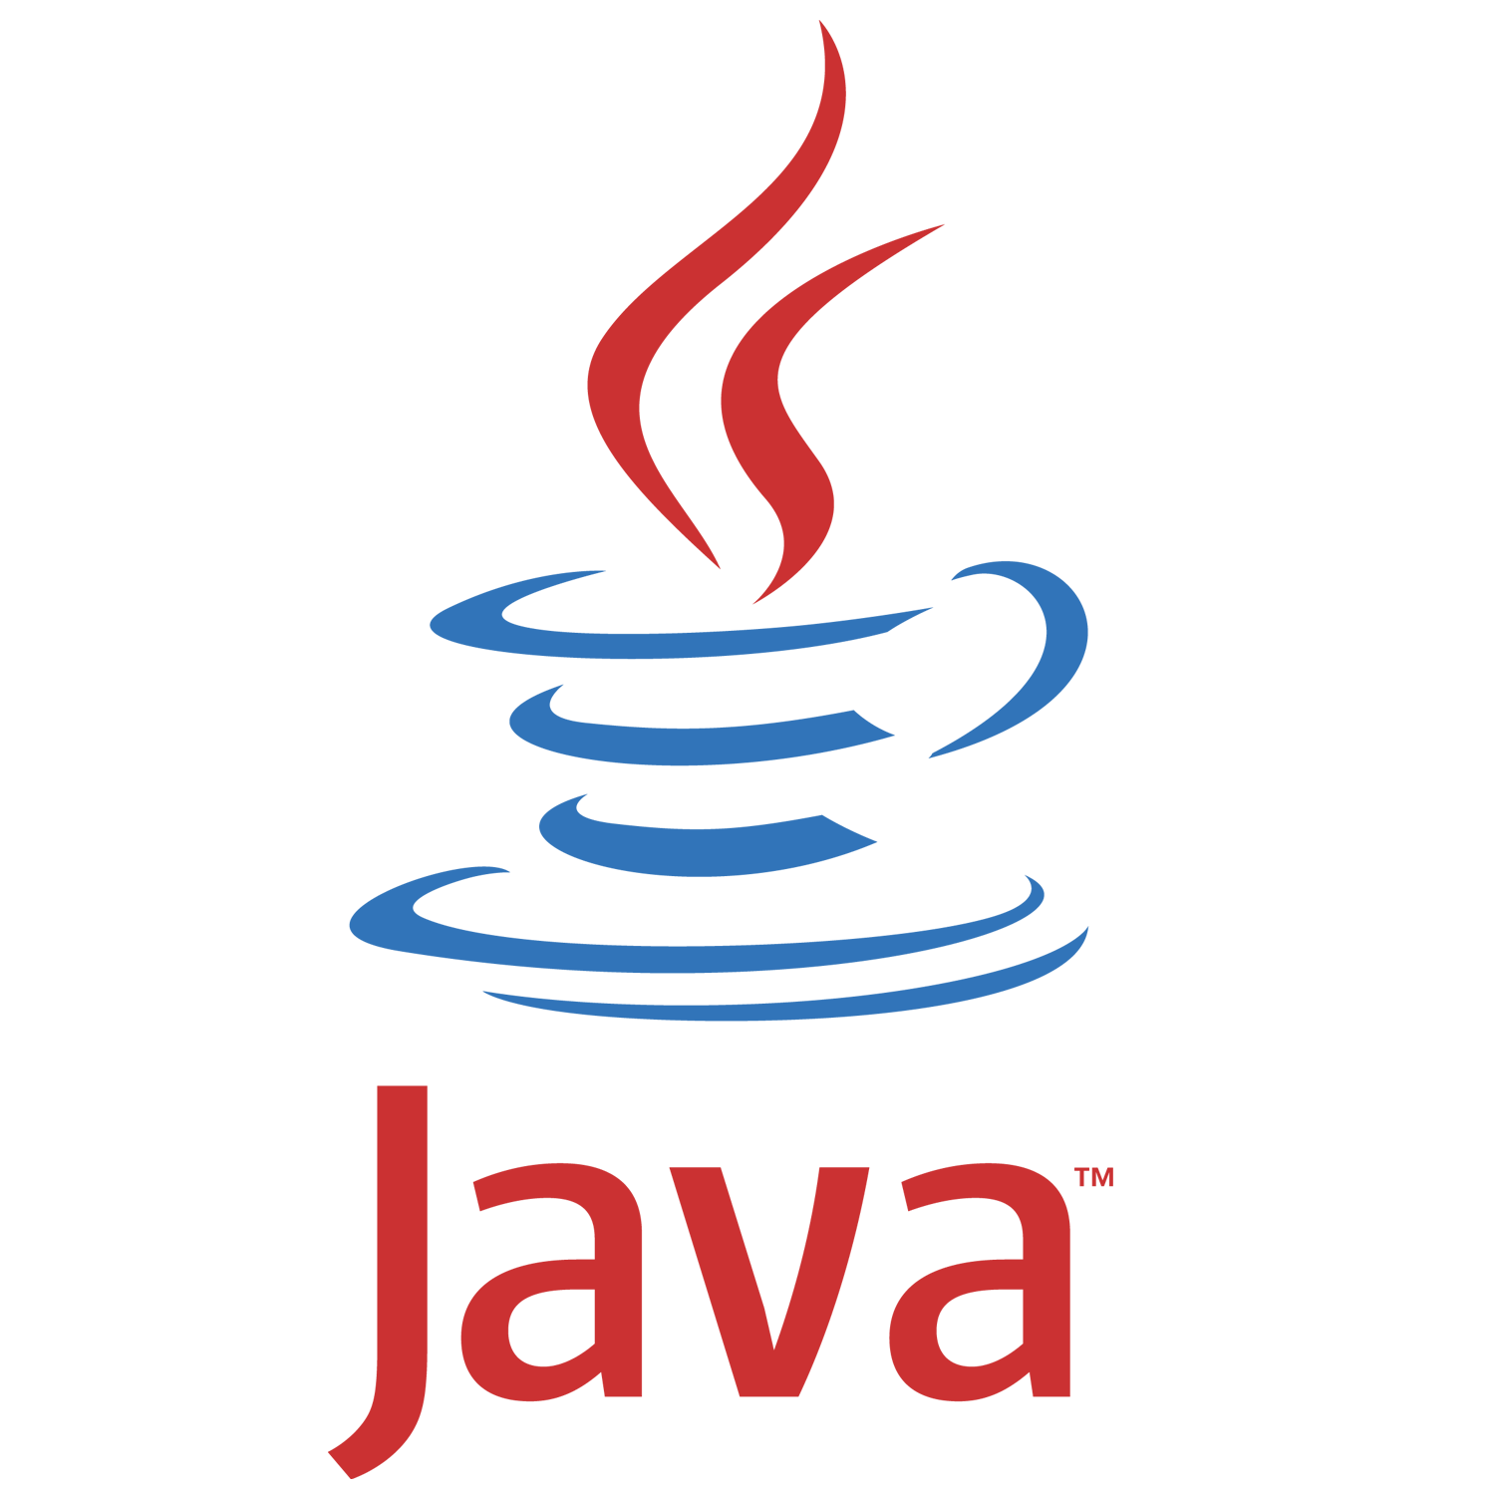
Features of Java
The main objective of Java programming language creation was to make it portable, simple and secure programming language. Apart from this, there are also some awesome features which play important role in the popularity of this language.
It is easy to learn and its syntax is simple, clean and easy to understand.
Simple
Dynamic
A source code written in one platform, the same code can be executed in any platform.
It facilitates you to carry the java bytecode to any platform.
Portable
Interpreted
It compile class file and converted to bytecode that is interpreted on JVM.
Everything in Java is an object.
Object-oriented
High Performance
It is faster than traditional interpretation since bytecode is "close" to native code.
Java is a write once, run anywhere language.
Platform independent
Multithreaded
It deals with many tasks at once by defining multiple threads executing concurrently.
It has no explicit pointer & it runs inside virtual machine sandbox.
Secured
Distributed
It facilitates us to create distributed applications in java.
It’s has no implementation dependent features e.g. fixed primitive types size.
Architecture neutral
Robust
It is using strong memory management & automatic garbage collection.
source: https://www.javatpoint.com/features-of-java
Notes:
https://www.javatpoint.com/features-of-java

Slide 4
The Java Editions
Java Platform, Standard Edition (Java SE)
Java Platform, Enterprise Edition (Java EE)
Java Platform, Micro Edition (Java ME)
https://docs.oracle.com/javaee/6/firstcup/doc/gkhoy.html

Slide 5
The Java Editions
Provides the core functionality of the Java programming language. It defines everything from the basic types and objects of the Java programming language to high-level classes that are used for networking, security, database access, graphical user interface (GUI) development, and XML parsing.
It consists of a virtual machine, development tools, deployment technologies, and other class libraries and toolkits commonly used in Java technology applications.
Java Platform, Standard Edition (Java SE)

Slide 6
The Java Editions
It is built on top of the Java SE platform. The Java EE platform provides an API and runtime environment for developing and running large-scale, multi-tiered, scalable, reliable, and secure network applications.
Java Platform, Enterprise Edition (Java EE)

Slide 7
The Java Editions
It provides an API and a small-footprint virtual machine for running Java programming language applications on small devices, like mobile phones.
The API is a subset of the Java SE API, along with special class libraries useful for small device application development. Java ME applications are often clients of Java EE platform services.
Java Platform, Micro Edition (Java ME)

Slide 8
The Java Virtual Machine
Java Virtual Machine (JVM) is a virtual machine that resides in the real machine and the machine language for JVM is byte code. Each Java source ﬁle is compiled into a bytecode ﬁle, which is executed by the JVM.
Java Byte Code is the language to which Java source is compiled and the Java Virtual Machine understands.
JVM specification provides a runtime environment to run Java program which is called JRE (Java Runtime Environment).
It is using a compiler tool to convert those java files to bytecodes which is included on the JDK (Java Development Kit).
JDK is a set of software, tools and libraries that can be used directly by Java programs.

Slide 9
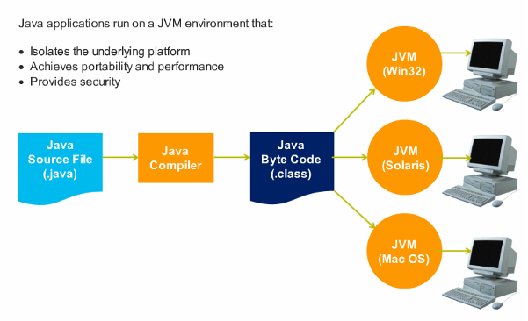
The Java Virtual Machine
Java was designed to allow application programs to be built that could be run on any platform, without having to be rewritten or recompiled by the programmer for each separate platform.
jvm
jvm
jvm

Slide 10
The Java Virtual Machine
The diagram shows each step in the process of compiling and executing a Java program.
Java source code
3
The JVM executes the interpreted code.
1
The source code (.java) is compiled by JDK into byte code
JDK
Java byte code
2
Java compiler
The JVM interprets the byte code.
JVM
JRE
Hardware Platform

Slide 11

Starting a Java Program
Check operating software (OS) types and configurations if it is a 32 or 64 bit on your machines.
To write a Java program , you’ll need to download and install the runtime environment on your machines.
Go to Java SE download sites and select JDK for your OS system requirements
JAVA
Run the downloaded installer which installs both JDK and JRE to the default directory.
Programming Language
Runtime Environment
Include the JDK’s bin directory in the PATH environment variable (system variable) to run JDK programs.
Verify the JDK installation showing the version install in command prompt e.g. # java -version
source: https://docs.oracle.com/javase/8/docs/technotes/guides/install/install_overview.html
Notes:
https://docs.oracle.com/javase/8/docs/technotes/guides/install/install_overview.html
Demo

Slide 12
Starting a Java Program
Once the Java runtime environment has already setup you can start writing the code using a simple text editor such as notepad.
Create a source file contains a code written in Java language. It should save as .java.
Compile the source file into .class file using javac command e.g. # javac <*.java file>
JAVA
Run the program using java command or the application launcher tool that uses the JVM.
Programming Language
Runtime Environment
On the directory where the compiled filed located you need to execute the command # java –cp <classname>.
The static main method will be the entrypoint to invoked first when running java program.
source: https://docs.oracle.com/javase/8/docs/technotes/guides/install/install_overview.html
Notes:
https://docs.oracle.com/javase/8/docs/technotes/guides/install/install_overview.html
Demo

Slide 13
Importing classes
A Java class is a group of objects which have common properties. It is a template or blue print from which objects are created.
Syntax:
modifier class ClassName { //class header
//field, constructor, interface
//method declarations
//nested class
}
Class A
Class B
Class C
Notes:
Demo

Slide 14
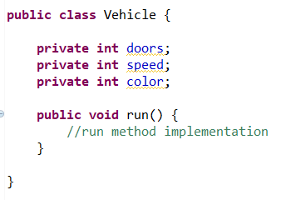
Importing classes
Class members: Instance variables
-created inside the class but outside the method.
-it gets its memory at run time when object is created.
Access modifier:
public (+) : Accessible to all
protected (#) : Class & subclasses can call
default (~) : Can be called any classes within package
Private (-) : Class methods only and not classes
Class members: Methods
-collection of statements that are group together to perform an operation.
Notes:
Demo

Slide 15
Importing classes
A java package is a group of similar types of classes, interfaces and sub-packages.
Package in java can be categorized in two form, built-in package and user-defined package.
There are three ways to access the package from outside the package.
import package.*;
import package.classname;
fully qualified name.
The import keyword is used to make the classes and interface of another package accessible to the current package.
Java
Java package
lang
Util
awt
Java sub packages
System.class
ArrayList.class
Button.class
Java classes
String.class
Map.class
source: https://www.javatpoint.com/package
Notes:
https://www.javatpoint.com/package
Demo

Slide 16
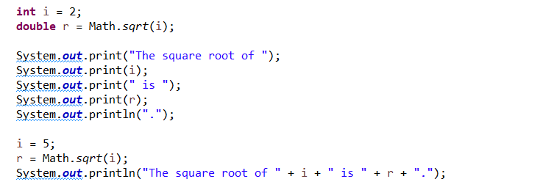

Formatting the output
In Java, instances of PrintStream and PrintWriter implement a standard set of write methods for simple byte and character output.
Invoking print or println outputs a single value after converting the value using the appropriate toString method.
toString method is a string representation of an object.
Output in the console:
Note: The i and r variables are formatted and utilizes toString method during compile.
Notes:
Demo

Slide 17
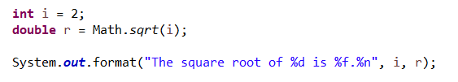
Formatting the output
The format method formats multiple arguments based on a format string.
Output in the console:
d formats an integer value as a decimal value.
f formats a floating point value as a decimal value.
n outputs a platform-specific line terminator.
Note: All format specifiers begin with a % and end with a 1- or 2-character conversion that specifies the kind of formatted output being generated..
Notes:
Demo

Slide 18
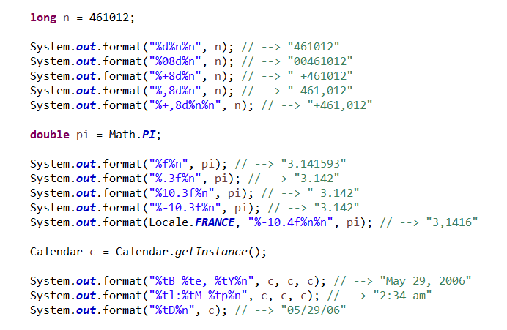
Formatting the output
More examples on using format method for numeric and dates.
Note: The output is shown with double quotes in the embedded comment.
source: https://docs.oracle.com/javase/tutorial/java/data/numberformat.html
Notes:
https://docs.oracle.com/javase/tutorial/java/data/numberformat.html
Demo : com.beacon.java.demo.module1. FormattingOutput

Slide 19
Formatting the output
Conversions are divided into the following categories:
General - may be applied to any argument type
Character - may be applied to basic types which represent Unicode characters: char, Character, byte, Byte, short, and Short. This conversion may also be applied to the types int and Integer returns true
Integral - may be applied to Java integral types: byte, Byte, short, Short, int and Integer, long, Long, and BigInteger
Floating Point - may be applied to Java floating-point types: float, Float, double, Double, and BigDecimal
Date/Time - may be applied to Java types which are capable of encoding a date or time: long, Long, Calendar, Date and TemporalAccessor
Percent - produces a literal '%' ('\u0025')
Line Separator - produces the platform-specific line separator
Notes:
Demo

Slide 20
Formatting the output
Conversion | Argument Category | Description
'b', 'B' | general | If the argument arg is null, then the result is "false". If arg is a boolean or Boolean, then the result is the string returned by String.valueOf(arg). Otherwise, the result is "true".
'c', 'C' | character | The result is a Unicode character
'd' | integral | The result is formatted as a decimal integer
'e', 'E' | floating point | The result is formatted as a decimal number in computerized scientific notation
't', 'T' | date/time | Prefix for date and time conversion characters.
Notes:
Demo

